Slide 1
CSCE606 Project Report
Group members:
Anmin Fang, Dawei Xiang, Yiming Li

Slide 2
Content
Customer requirement
Brief description of the project
User stories
BDD & TDD process
Issues we met
Other tools
Selected product display

Slide 3
Customer Requirement
Based on the large demand for tutoring in this university of 55,000 undergraduate students, our customers want to build a web platform for a senior students to post tutoring information and for junior students to seek proper teachers in the website.

Slide 4
Content
Customer requirement
Brief description of the project
User stories
BDD & TDD process
Issues we met
Other tools
Selected product display

Slide 5
Brief description of the Project
Students could register on our website as tutors and post their available tutoring courses. The post includes title, tutor major, available date, self-description, and price. Other students could search for tutors or posts that match their interests on our website. In the future, this application can be extended into broader fields like used things sales information, activities information centers where anything happens on that physical board.

Slide 6
Content
Customer requirement
Brief description of the project
User stories
BDD & TDD process
Issues we met
Other tools
Selected product display

Slide 7
User Stories
– User signup
As a student
I want to sign up as a tutor.
I want to be added to the database and displayed on the home page.

Slide 8
User Stories
– User profile edit
As an user
I want to edit my profile so that others can see my tutor area
I want to update my profile

Slide 9
User Stories
– Search tutors’ posts
As a student
I can find tutors
I can search by different categories, like major, price…

Slide 10
User Stories
– User post
As an user
I want to post my tutor schedule and major with price.
I want to post.

Slide 11
Content
Customer requirement
Brief description of the project
User stories
BDD & TDD process
Issues we met
Other tools
Selected product display

Slide 12
BDD & TDD process
We developed our platform following BDD combined with TDD. At each iteration, we developed a few user processes and user needs based on the user stories we finished at the beginning. Then we wrote test cases for these user stories. We first implemented our code to pass the test. Later we refactored our code to make it cleaner and more efficient.

Slide 13
BDD & TDD process
BDD helped us capture what we should do in each iteration. Following the general target, we wrote our test cases to guide the detailed code implementation in TDD. Developing in TDD alone forces us to change the code every time we add a new test implementation, while in BDD alone, it’s hard to check special test cases and we don’t have a specific target. So we adopt BDD + TDD.

Slide 14
Content
Customer requirement
Brief description of the project
User stories
BDD & TDD process
Issues we met
Other tools
Selected product display

Slide 15
Issues we met
The development database is different from the production database. So we configure the database again in Heroku.

Slide 16
Content
Customer requirement
Brief description of the project
User stories
BDD & TDD process
Issues we met
Other tools
Selected product display

Slide 17
Other tools
We used SimpleCov to analyze our code. SimpleCov automatically tests our project and generates test results reports, thus we could easily know the coverage across our test suites.

Slide 18
Content
Customer requirement
Brief description of the project
User stories
BDD & TDD process
Issues we met
Other tools
Selected product display

Slide 19
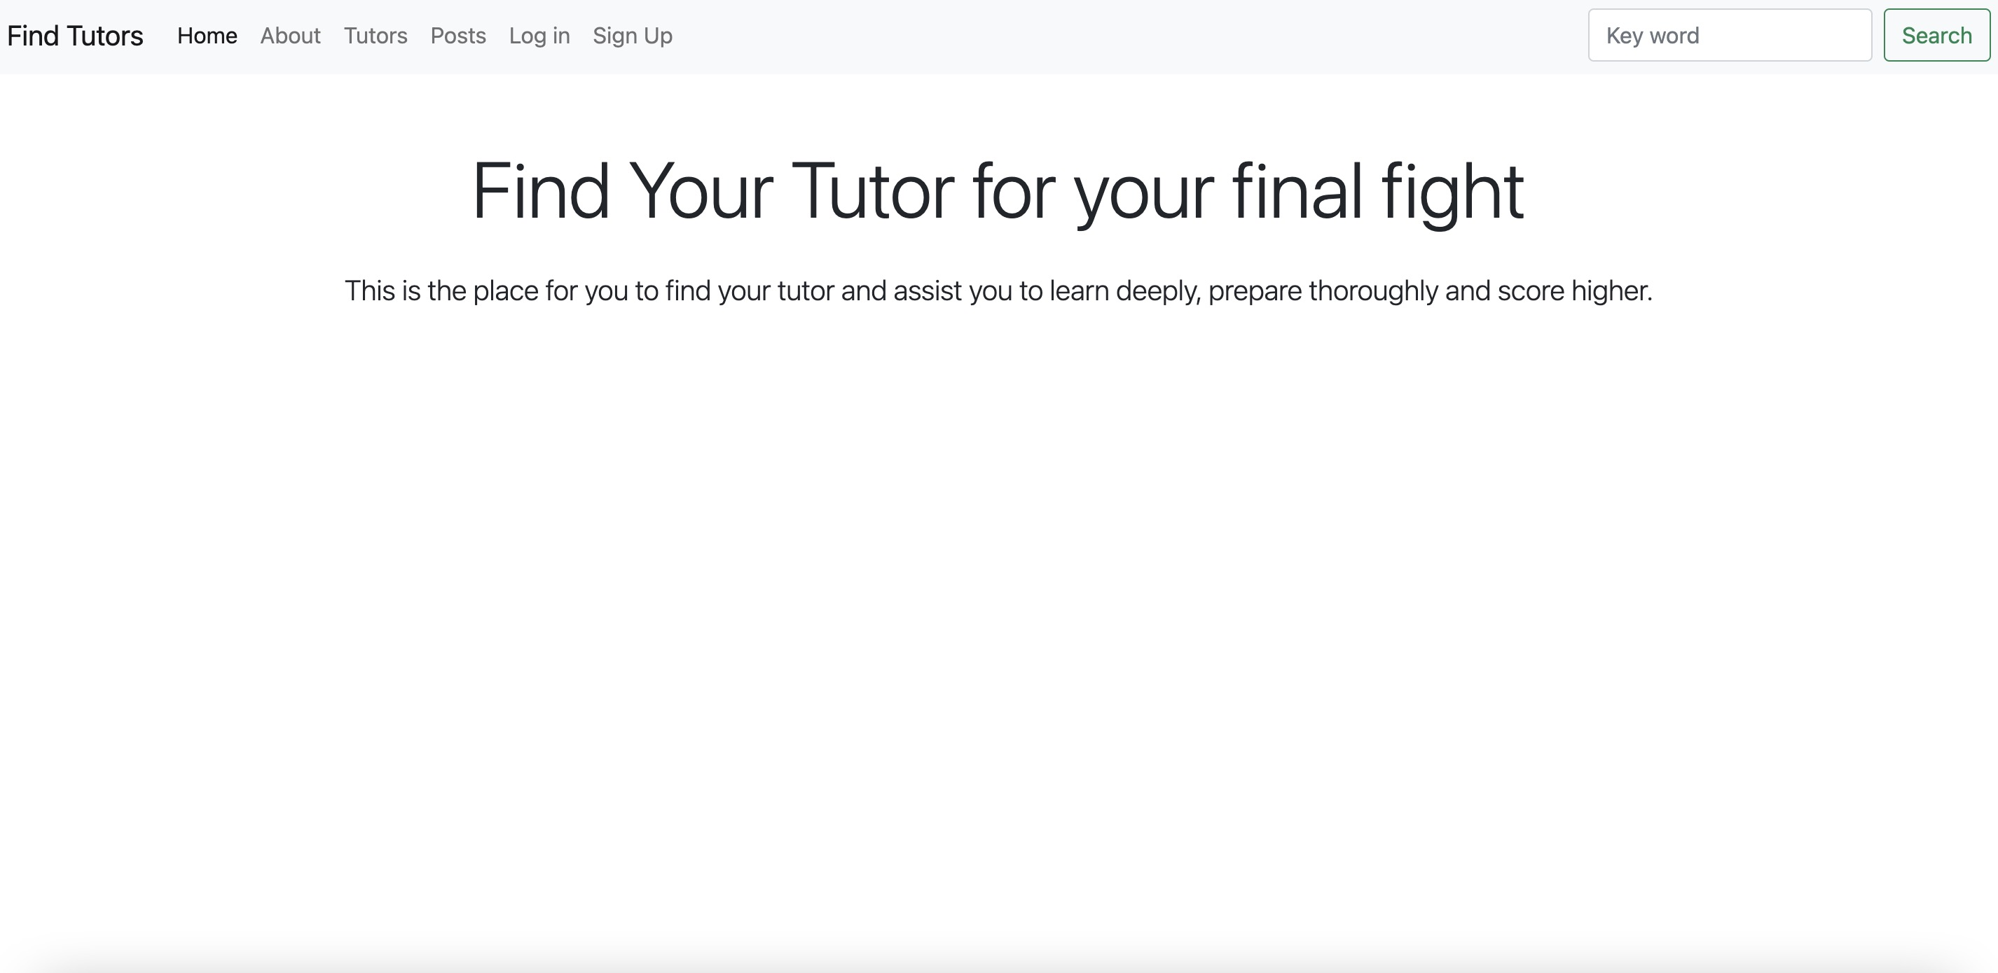
Selected product display
Home page

Slide 20
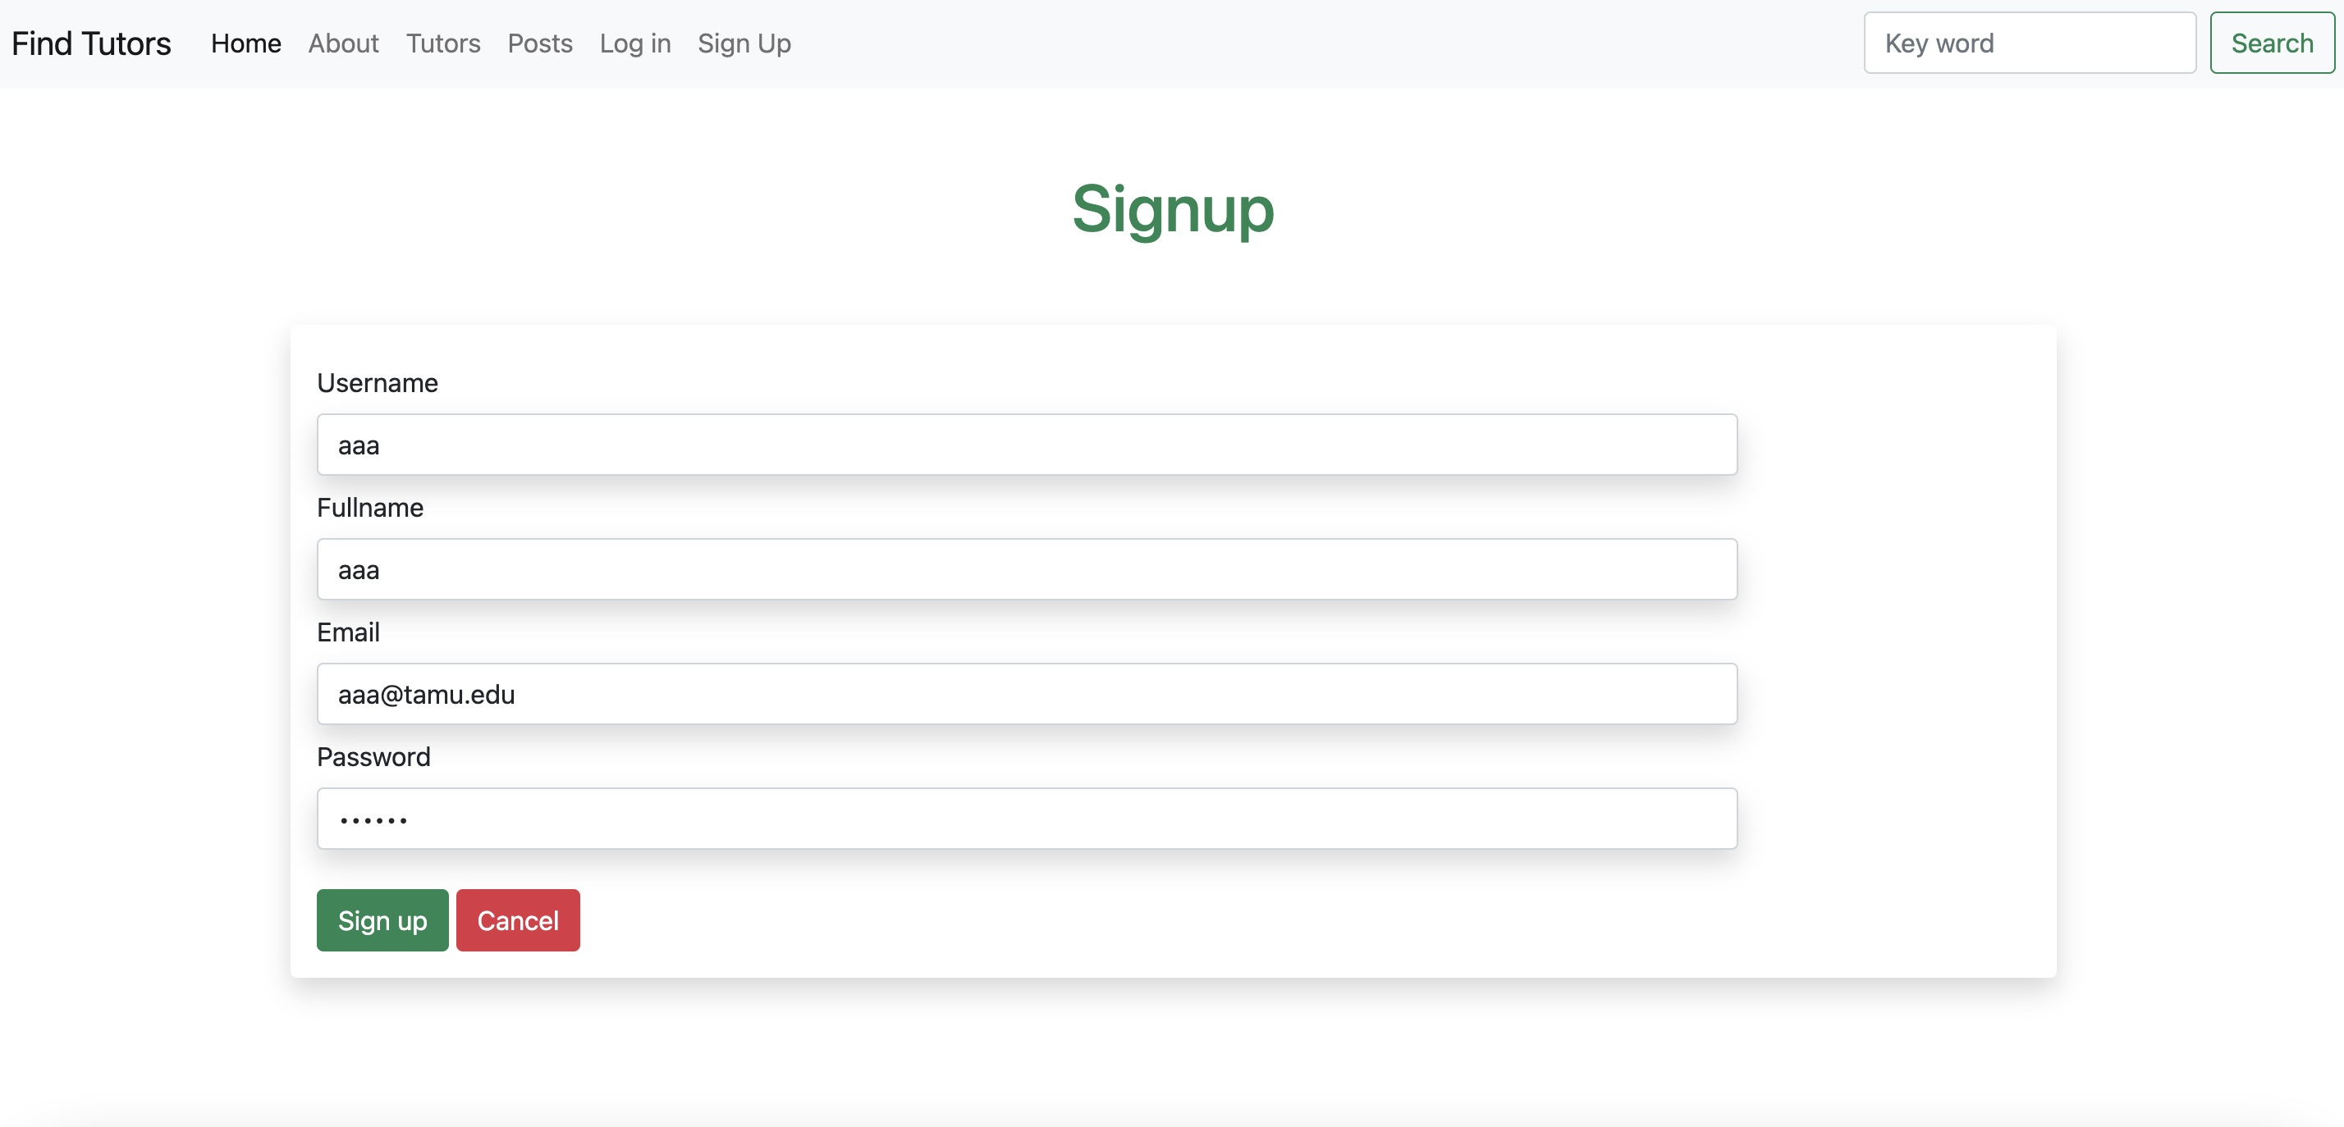
Selected product display
Sign up

Slide 21
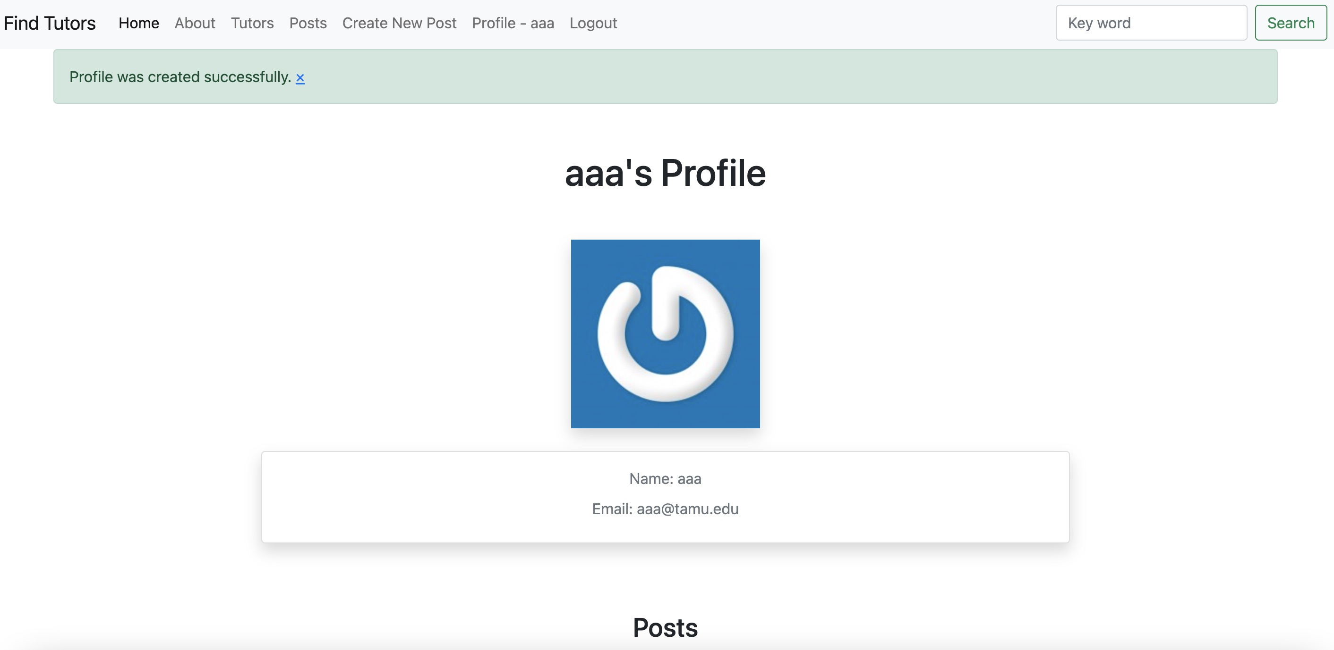
Selected product display
Profile was created successfully

Slide 22
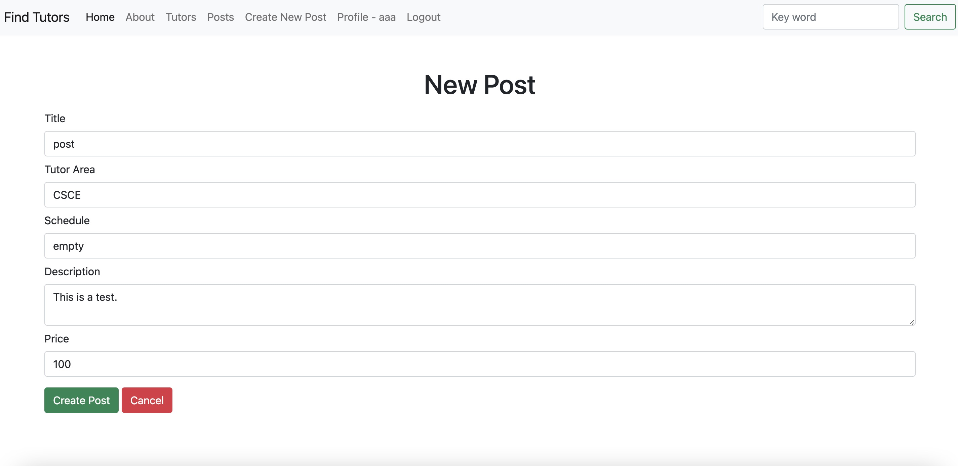
Selected product display
Create a new post

Slide 23
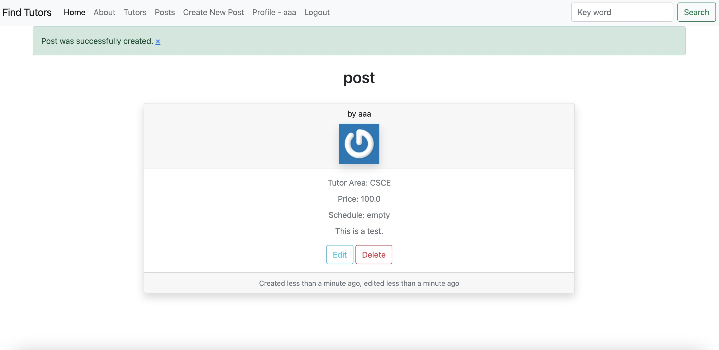
Selected product display
Post was created successfully

Slide 24
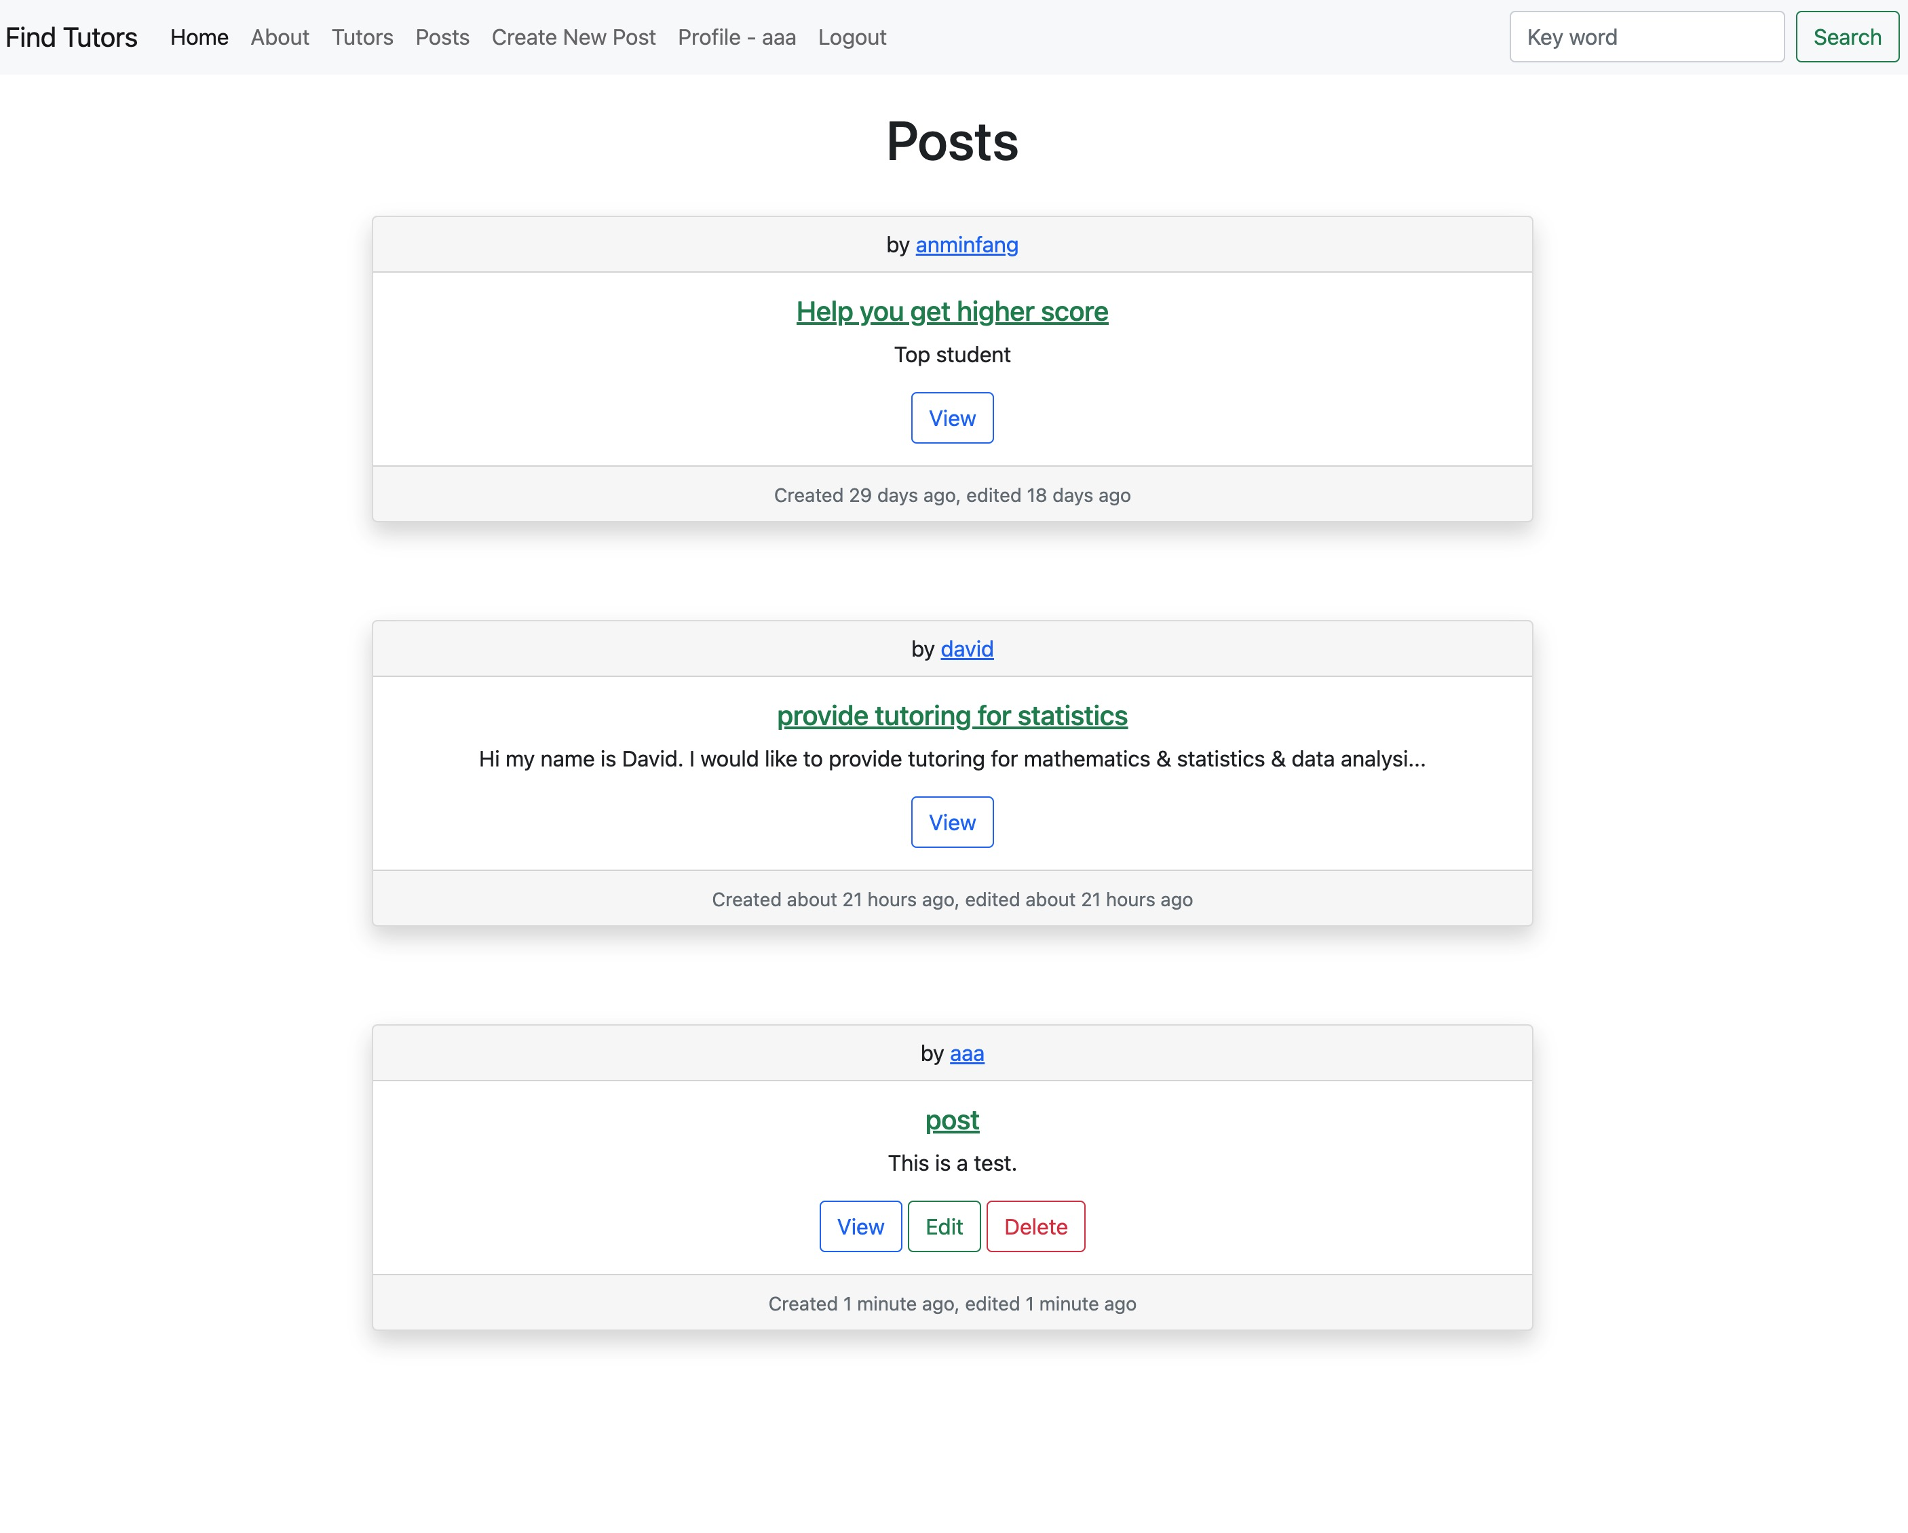
Selected product display
Show posts

Slide 25
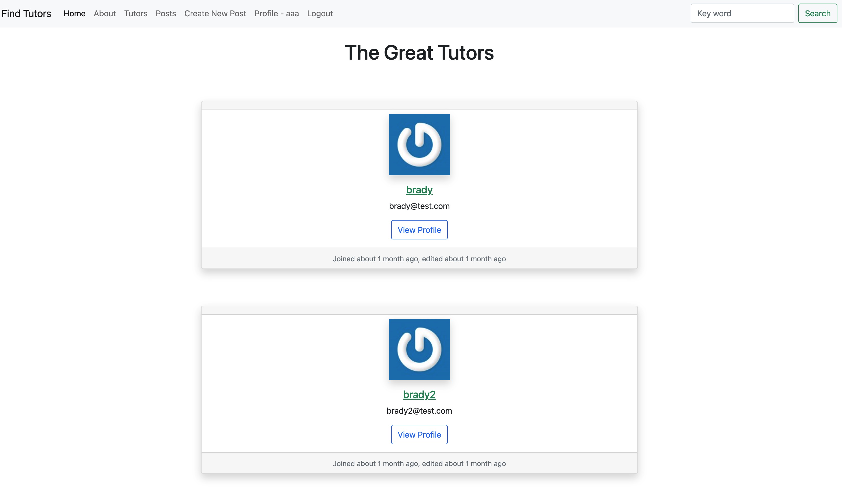
Selected product display
Show tutors

Slide 26
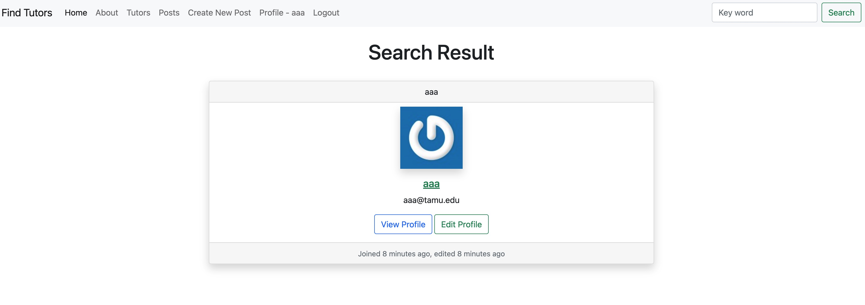
Selected product display
Search tutors

Slide 27
Thank You

